Slide 1


Options for Forest Bird Management
Coastal Operational Issues Forum
March 31, 2016

Slide 2
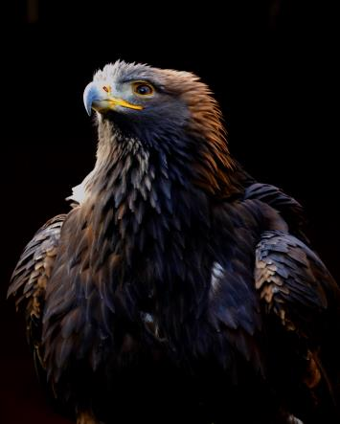

Outline
1. Issues/background
2. Approach
3. Management Approaches
4. Monitoring
5. Project Status
Golden Eagle
Photo: John Deal

Slide 3
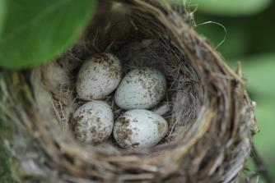
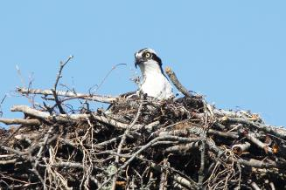
1. Issues/background
Current legislation on breeding birds
Migratory Bird Act
“… the harming of migratory birds and the disturbance or destruction of their nests and eggs”.
BC Wildlife Act
“a person commits an offense if the person …destroys (a) a bird or its egg, … or (c) a nest of a bird … when the nest is occupied by a bird or its egg
Herons, Osprey, Eagle protected year around
Yellow Warbler Nest
Photo: John Deal
Peregrine Falcon
Photo: John Deal
Osprey
Photo: John Deal

Slide 4
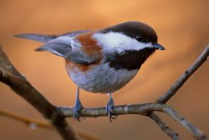
1. Issues/background:
Intent of project
To Provide:
Awareness
Minimize incidental take (avoidance)
Habitat Supply Options (mitigation)
Monitoring Options
Approach can be refined by tenure
Chestnut-backed Chickadee
Photo: John Deal
Notes:
To Provide:
Awareness - An awareness of breeding bird species most likely to be affected by forestry
Minimize Options to minimize the likelihood of incidental take
Options to manage breeding habitat supply for groups of species of most concern
Options to assess and monitor habitat supply and species to inform future management

Slide 5
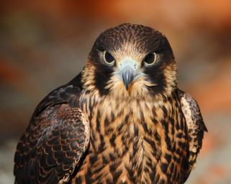
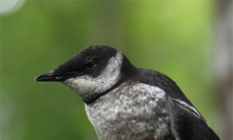
2. Approach: Birds most sensitive to coastal forestry
Determine Coastal Bird List
  297 species
  211 native species breeding on Coast
Determine Habitat Requirements
Assign Species to Habitat Groups
  1: Habitat Generalists
  2: Associated with broad habitat type and seral stages (conifer, deciduous, wetlands, riparian)
  3: Associated with habitat structures like cavities, understory and down wood
  4: Associated with localized habitat
  5: Associated with habitat pattern
  6: Not affected by forestry and incidental
Peregrine Falcon
Photo: John Deal
Marbled Murrelet
Photo: John Deal

Slide 6
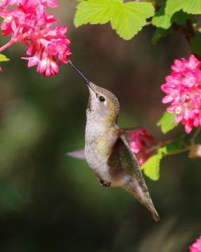
3. Management Approaches
Three Main Steps
Avoid/conserve known nests
Assessing landbase
Further avoidance
and Mitigation options
Anna’s Hummingbird
Photo: John Deal

Slide 7
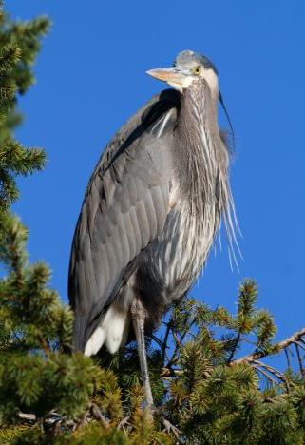
4. Monitoring Options
  1) Habitat monitoring
    amount
    elements
    patterns
  2) Species Monitoring
  validate/refine assumptions
  if habitat fall to low levels
  species with localized habitats
  - targeted breeding birds surveys
  - use existing information
Great Blue Heron
Photo: John Deal

Slide 8
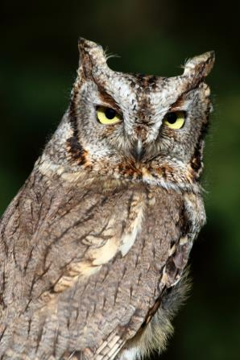
4. Monitoring
  3) Success of conservation actions
    Conserving habitats
    Creating nesting sites
    Restoring habitat
    Maintaining stick nests
    Buffering active nests
    Effectiveness of training
Western screech-owl
Photo: John Deal

Slide 9
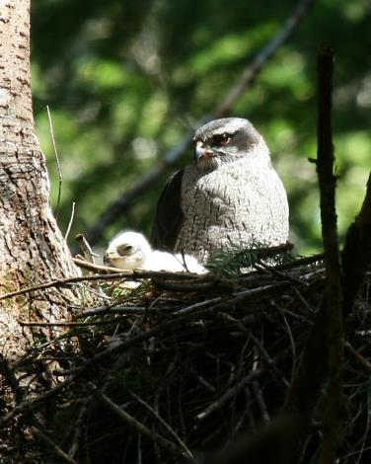
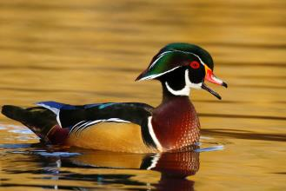
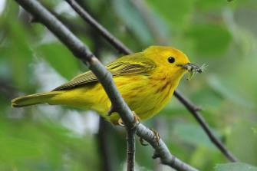
5. Project Status
Report
  Final draft complete
  Includes an EC review
Upcoming
    May 2016: Implementation
Northern Goshawk
Photo: John Deal
Wood Duck
Photo: John Deal
Yellow Warbler
Photo: John Deal

Slide 10

Thank you

